Slide 1

DIGITAL’S
HANDOVER
Prepared by Khoi Ta

Slide 2
Monthly Tasks

Slide 3
Monthly Tasks - Report
Monthly GMAL performance
Step 1: access folder (1), open the latest report file
Step 2: fill in the metrics that you’d like to report
Notes:
Performance & Performance Drill down: refer numbers from Marketing Dashboard (2)
Users: refer number from Plexure analytics (3)
Company dashboard
Beginning of each month, Jack (dung.nong@vn.mcd.com) will send a request to fill in performance of digital in Scorecard file
Scroll down to the 4Ds part, fill in the number for digital in the first 3 rows (they will be using the same number with monthly GMAL performance report)
Notes: fill in the numbers for that particular month and QTD as well
Promotion report
Step 1: Access Digital offer report dashboard (4)
Step 2: filter by year, month and channel that you’d like to report
Step 3: filter PromotionName with following values: “Crew Drink”, “Internal - Crew Meal”, “Testing - New Crew Meal”, “Manager Drink - 35K off”, “Internal - Manager Meal”
Step 4: for each value, export the associated promotion cost and combine into 1 single file
Step 5: send the file to finance team for reclass (dao.le@vn.mcd.com)

Slide 4
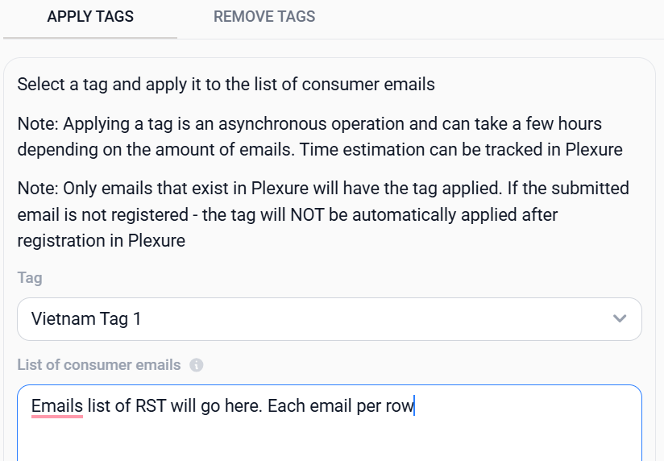
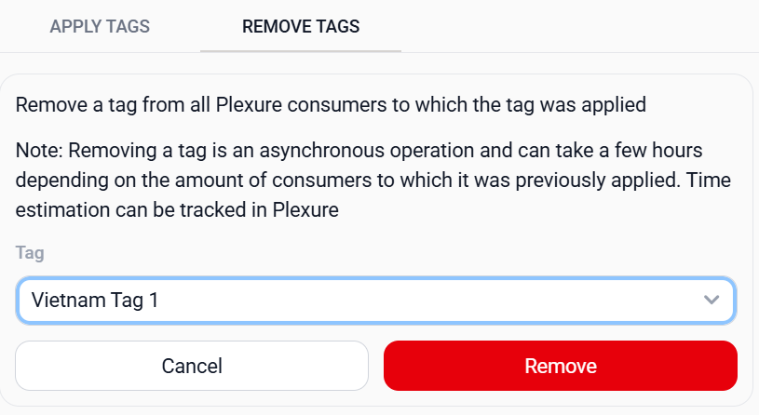
Monthly Tasks - Internal Tagging
Step 1: beginning of each month, HR team (quynh.tran@vn.mcd.com) will inform that the HR list is already updated on Monthly New hire folder (5)
Step 2: download the HR list, check if there is something wrong with all the emails of each group (RST, Crew, and Manager)
Step 3: access market engine (6) >> Tagging Tool >> Remove tag. Choose “Vietnam Tag 1” from the drop down list and click “Remove”. Do the same for “Vietnam Tag 2” and “Vietnam Tag 3”
Step 4: Move to “Apply tag”. Paste the email list from step 2 in the box and choose the tag type associated with that email list (Vietnam Tag 1 for RST list, Vietnam Tag 2 for Crew list, Vietnam Tag 3 for Manager list) then click apply

Slide 5
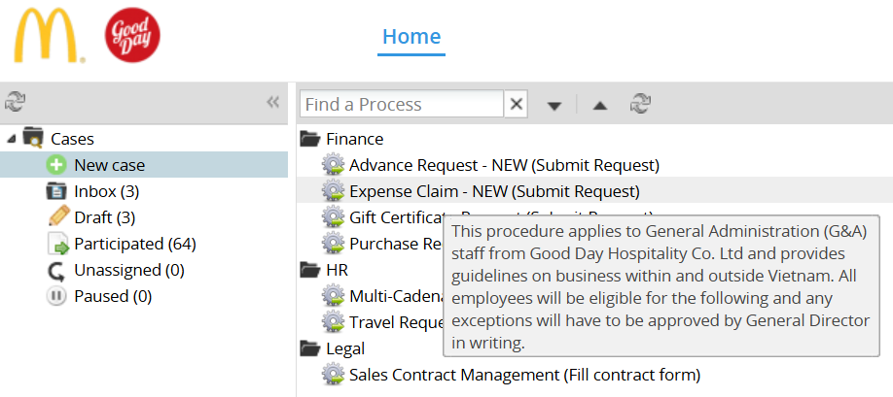
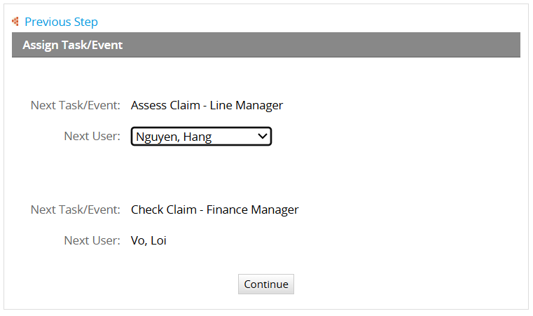
Monthly Tasks - System Billing
Step 1: beginning of each month, Kochava and Plexure will send billing invoice of last month to your email. You will need to reply those email with your confirmation on the payment amount
Step 2: Access to process maker (7) >> New case >> Expense claim - NEW (Submit request)
Step 3: Fill in the details of all mandatory fields, attach the invoice then click Submit
Step 4: you will need to choose line manager from the drop down list, then click Continue
Step 5: once you receive the email notification that the request is approved, print out the Claim request, confirmation email, invoice and hand them to finance team (mydung.nguyen@vn.mcd.com) for making transaction

Slide 6
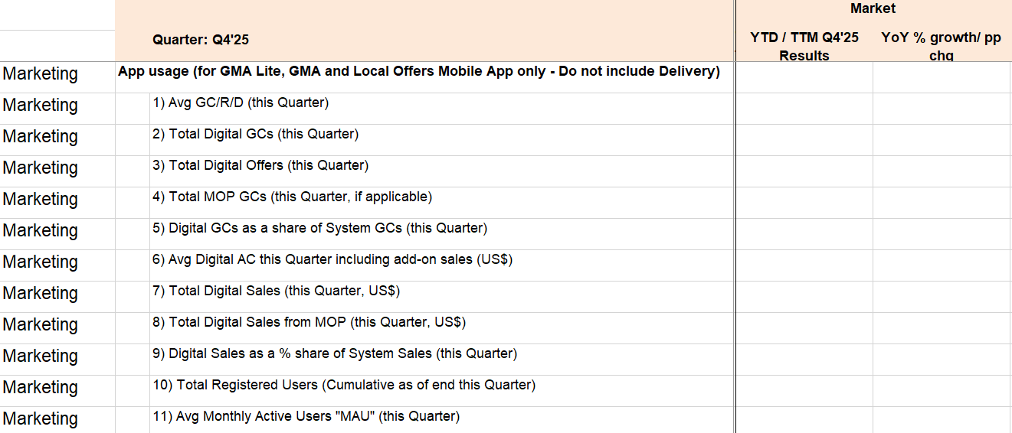
Quarterly ABU Report
At the end of each quarter, S&I team (viet.vo@vn.mcd.com) will send you a template called “Quarterly Dashboard” to report to ABU team. You can use the same metrics and data from other digital reports to fill all the rows as below

Slide 7
Adhoc Tasks

Slide 8
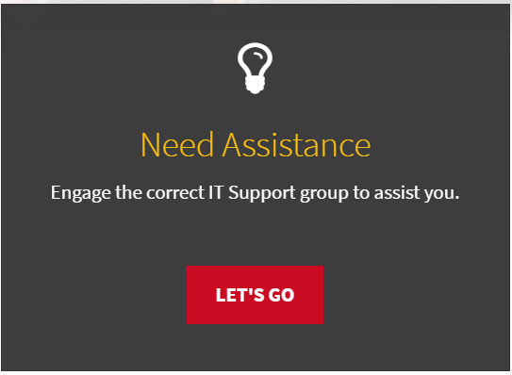
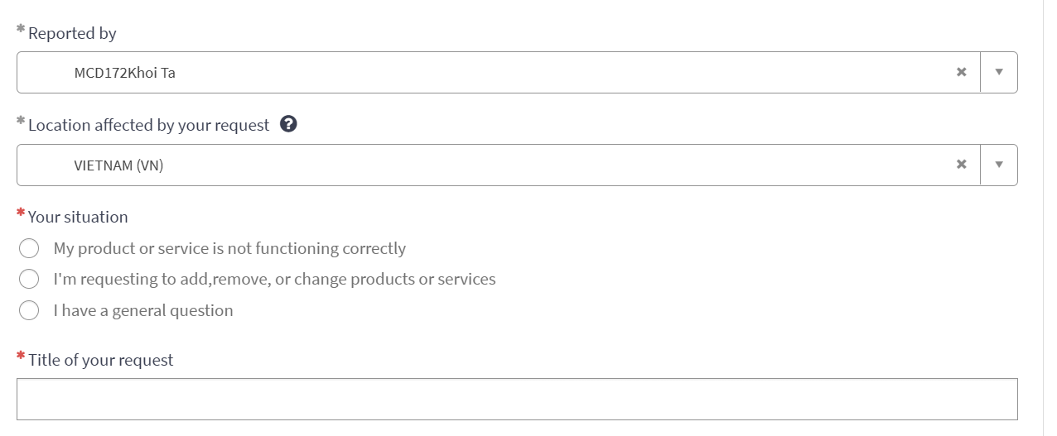
Support CC Team for customer complaints
When you receive enquiries from CC team (cskh@vn.mcd.com) regarding customers’ complaints about GMAL that you don’t have proper answer, you can raise a ticket to Service cafe team to ask them support
Step 1: access to Service cafe portal (8) and using your external McD email to log in
Step 2: Click on “Need assistance” >> Fill the request form with all the mandatory fields >> Submit
Step 3: Wait for their feedback after a few day then you can revert back to CC team for their answer
Note: sometimes, you will need to access Customer Care portal (9) to check customer’s account history, too. The error code definitions and how to reply to customers in such case are shared in access history.

Slide 9
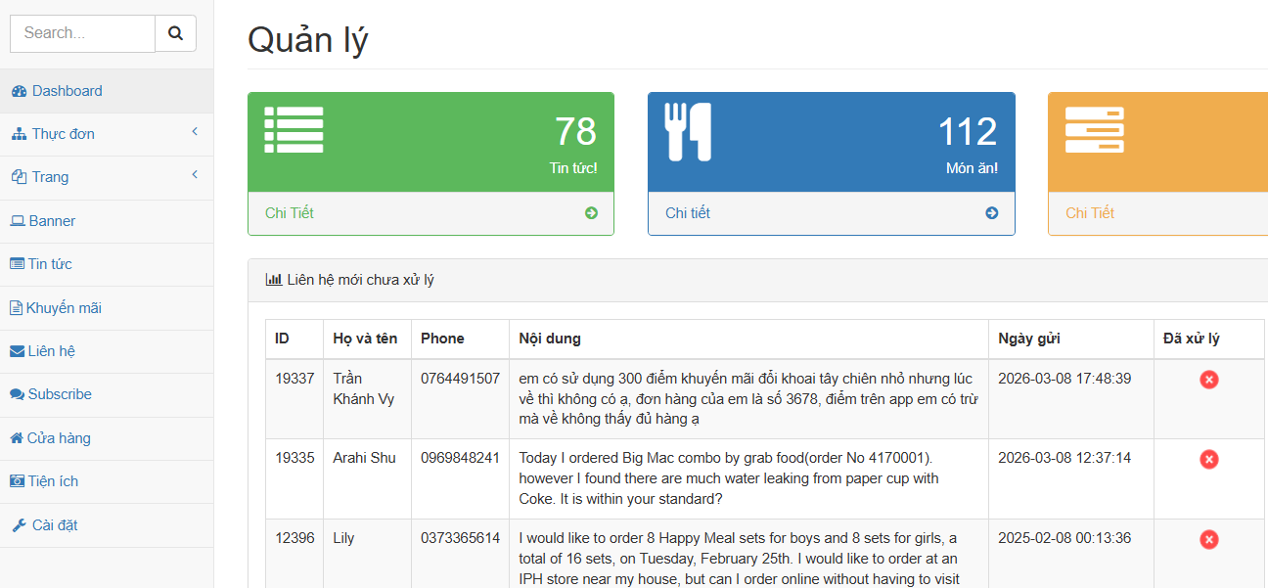
Edit banner and CMS on McD Website
Everytime you need to update banner or blog content on McD’s website, after logging in to admin dashboard (10), you can refer to following step
If you need to change banner, click on “Banner” >> Click “Chỉnh sửa” on the section you’d like to change >> upload & replace new banner
If you need to update new content, click on “Tin tức” >> Choose the article you’d like to edit or create a new one by clicking “Thêm mới”

Slide 10
Offer / Loyalty Reward / Push Notification
When you need to create or change offer, loyalty rewards or push notification on GMAL, you will need to log in to Plexure (11)
The guideline on how to use Plexure will be shared on Access Glossary (12)
Create new location for NSO
When a new store is opening, you will need to create a location for that store on Google My Business, McD’s website and app. Please note down the latitude and longitude of the location in advance
For Google My Business (13): click on “Thêm một doanh nghiệp” >> Fill in all the information of the store >> Publish and wait for Google’s approval
For Website: access to website admin dashboard (10) >> “Cửa hàng” >> “Thêm mới” >> Input store’s information and click “Thêm mới”
For GMAL app: access to market engine (6) >> Restaurant >> List >> Click on “+Create” button >> Fill in store’s information and click “Update”

Slide 11
Create code for 3rd parties rewards
There will be some time you want to create hidden reward code that customers can input into GMAL app and claim the rewards. Follow below step to create a new one
Step 1: Create a reward in Plexure >> Loyalty >> All loyalty cards >> 3-party redemption >> Create New Loyalty Reward >> Fill in all information and setup of reward >> Click “Publish”
Step 2: Note down the loyalty id (usually it will be 2046) and reward id of the reward that you just created
Step 3: Login to E-voucher dashboard (14) >> Quản lý Offer >> + Thêm offer >> Fill in all information of the reward you would like to create. Be noted to use exact loyalty id and reward id that you note on step 2
Step 4: You can export all the codes and send to vendors together with a guideline on how to claim hidden reward (15)

Slide 12
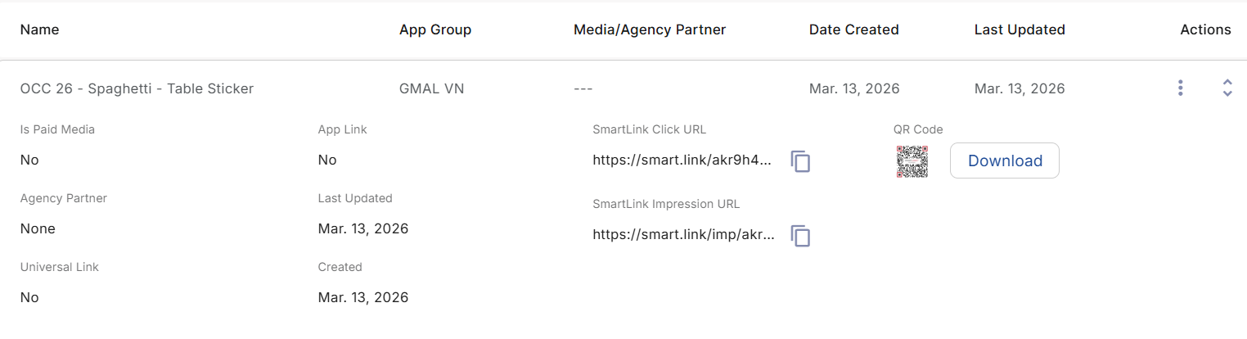
Create tracking QR code for campaigns
When you want to create a QR tracking code for a specific campaign, can follow below steps
Step 1: Access to Kochava platform (16)
Step 2: Go to navigation panel >> Engagement >> Smartlink
Step 3: Click on “+ Add a Smartlink” >> Fill in all information for General & Destination section >> Click save
Step 4: Click on the smartlink you just created to see the dropdown >> Click “Donwload” button next to QR code and embed it anywhere you want to track performance

Slide 13
On Going Projects

Slide 14
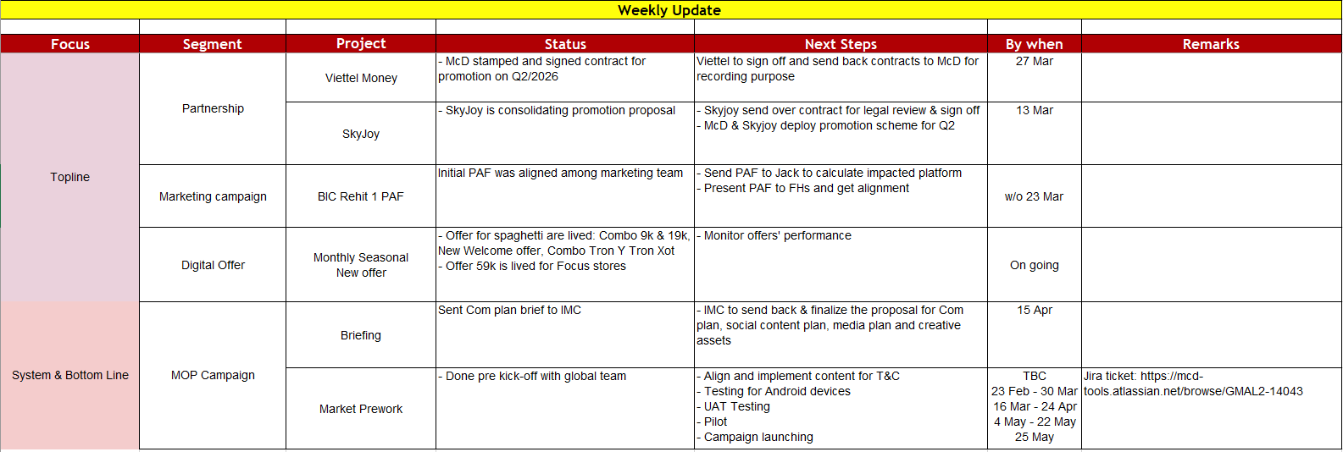
Detail WIP here

Slide 15
Access Glossary

Slide 16
Access Glossary
Categories | # | Name | Remarks
GMAL report | 1 | GMAL performance tracking template
 | 2 | Marketing Dashboard
 | 3 | Plexure analytics
Promotion report | 4 | Digital Offer Report
Internal Tagging | 5 | Monthly New hire list
 | 6 | Market Engine
System Billing | 7 | Process Maker

Slide 17
Customer support | 8 | Service cafe portal
 | 9 | Plexure Customer Care | How to use Customer Care Portal Error code definition
Website Update | 10 | Admin dashboard | Layer 1 User: mcdonalds | Pass: 123@2020 Layer 2 User: admin | Pass:Phuc@090
Offer / Reward / Push noti | 11 | Plexure
 | 12 | How to use Plexure | Banner Setup Offer Setup Push notification Setup
New Store Opening | 13 | Google My Business | Username: mcdonaldsvietnam.official@gmail.com Password: ManifestProfit2025!
Hidden Reward Code | 14 | E-voucher dashboard
 | 15 | Hidden Reward Redemption Flow
QR tracking code | 16 | Kochava

Slide 18

Thank you

