Slide 1
Plexure Onboarding

Slide 2
Agenda
Plexure Overview
User Management Module
Offers Management Module
Advertisement Module
Push Message Module
Market Engine Live Demo
Questions
Questions

Slide 3
Plexure Overview

Slide 4
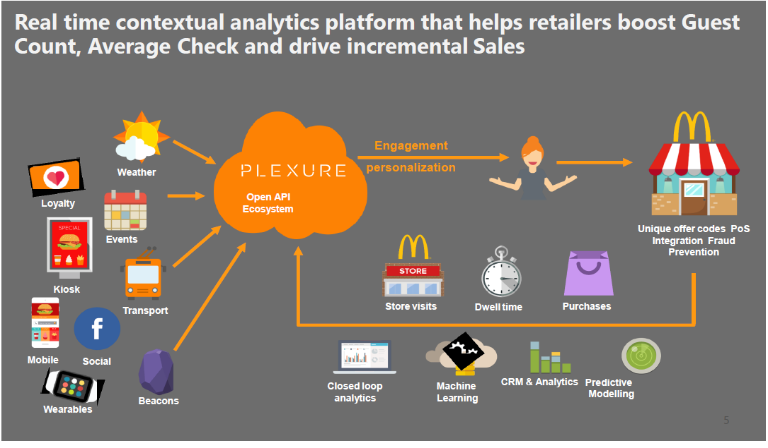
Plexure Overview

Slide 5
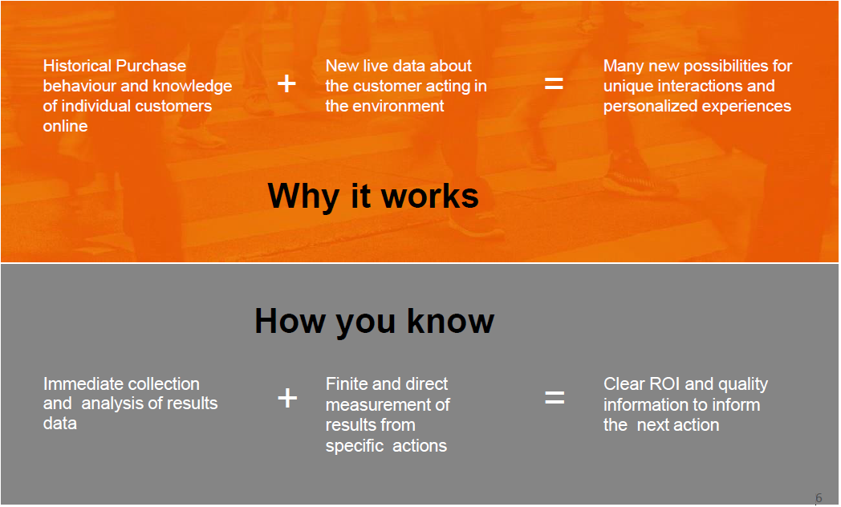
Plexure Overview

Slide 6
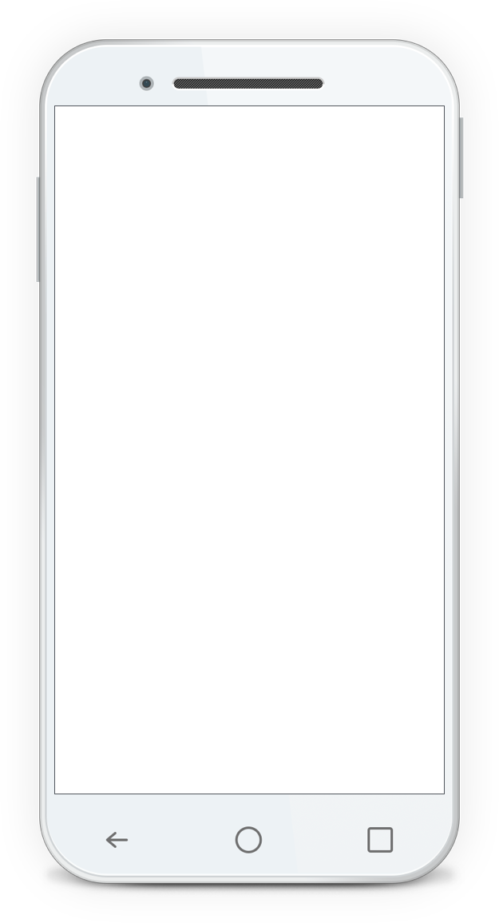
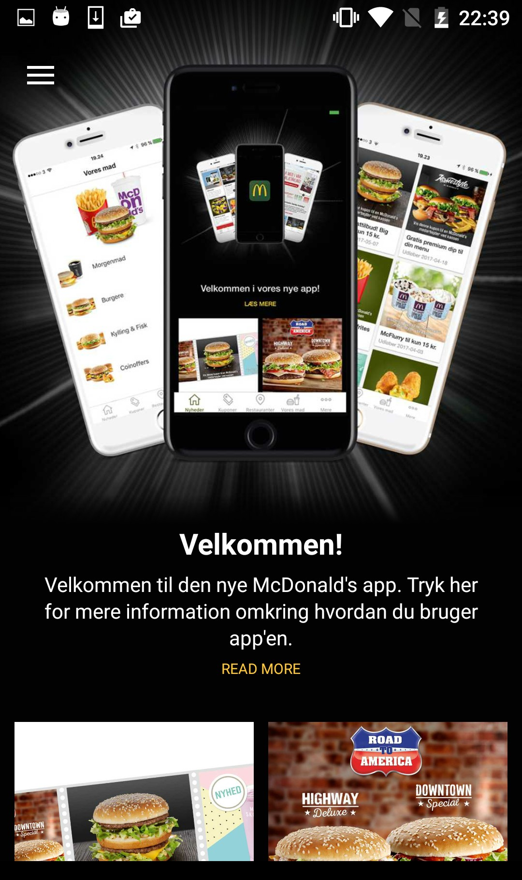
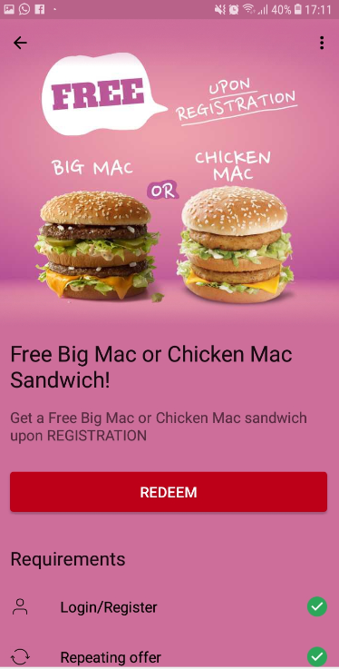
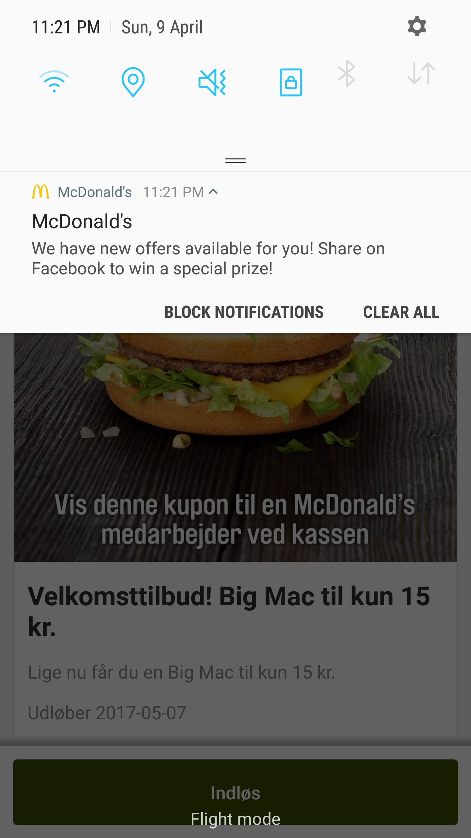
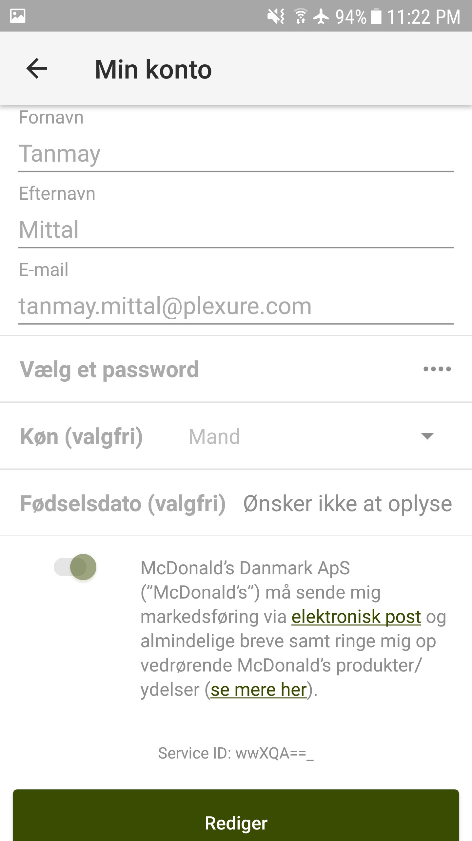
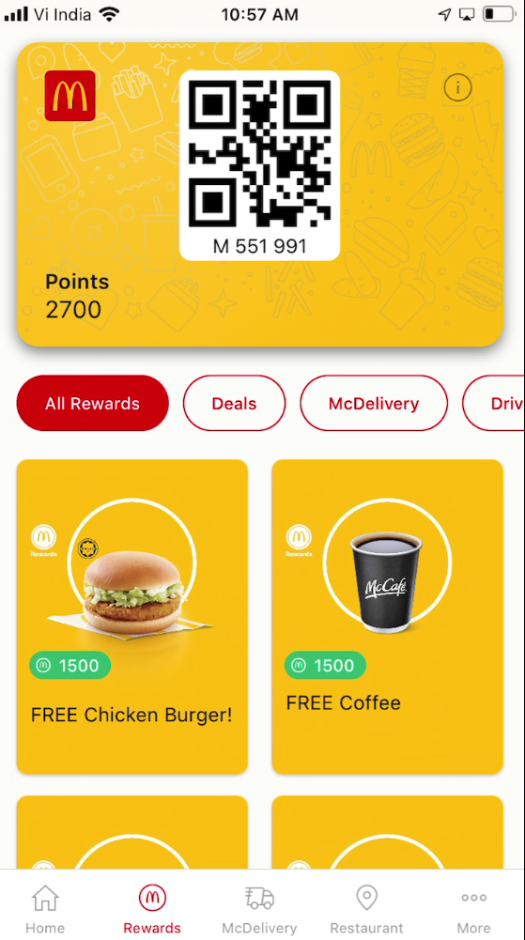
GMAL Plexure Features
Content managed via Plexure Platform
Advertisements
Deals/Offers
Push Messages
User Management
Loyalty Card

Slide 7
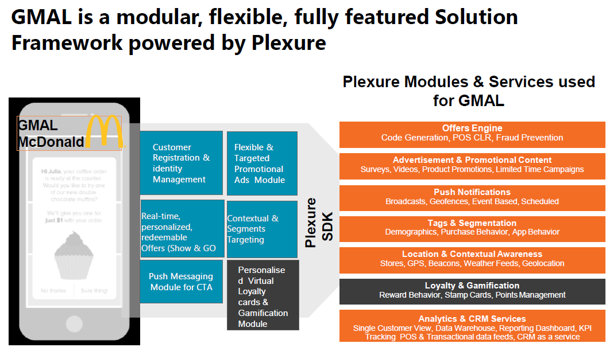
GMALite and Plexure

Slide 8
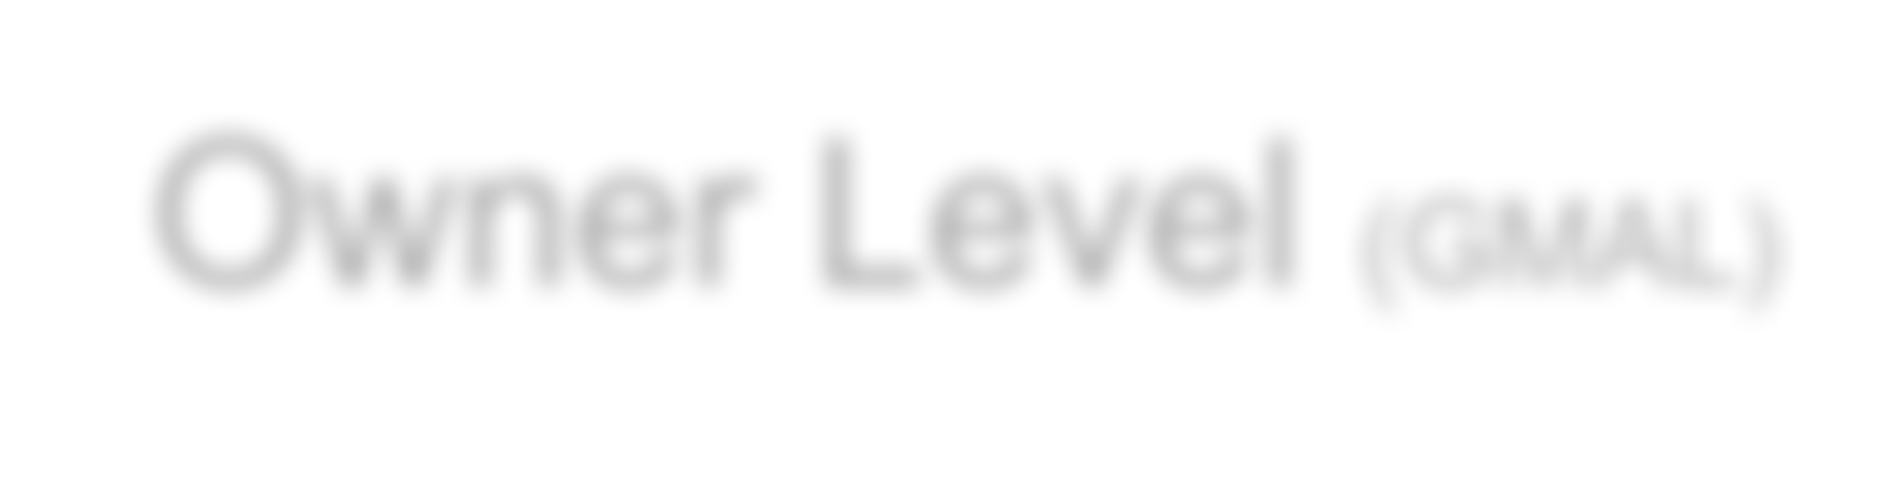
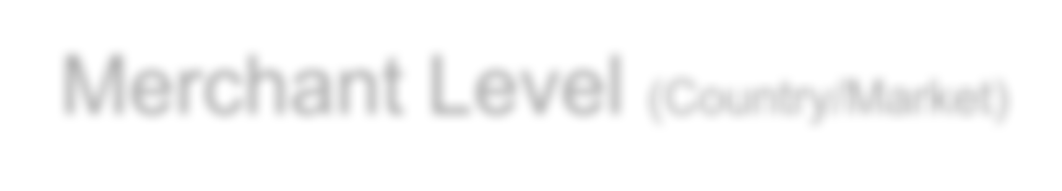
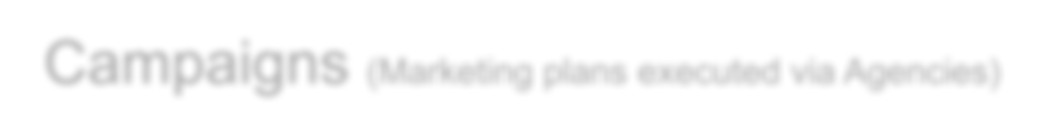




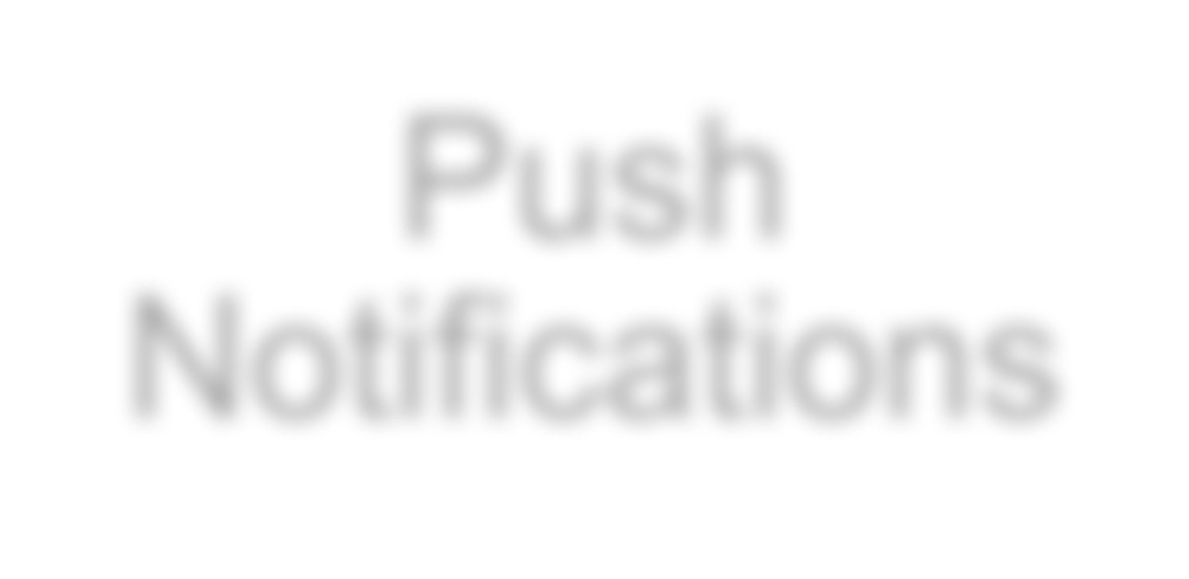
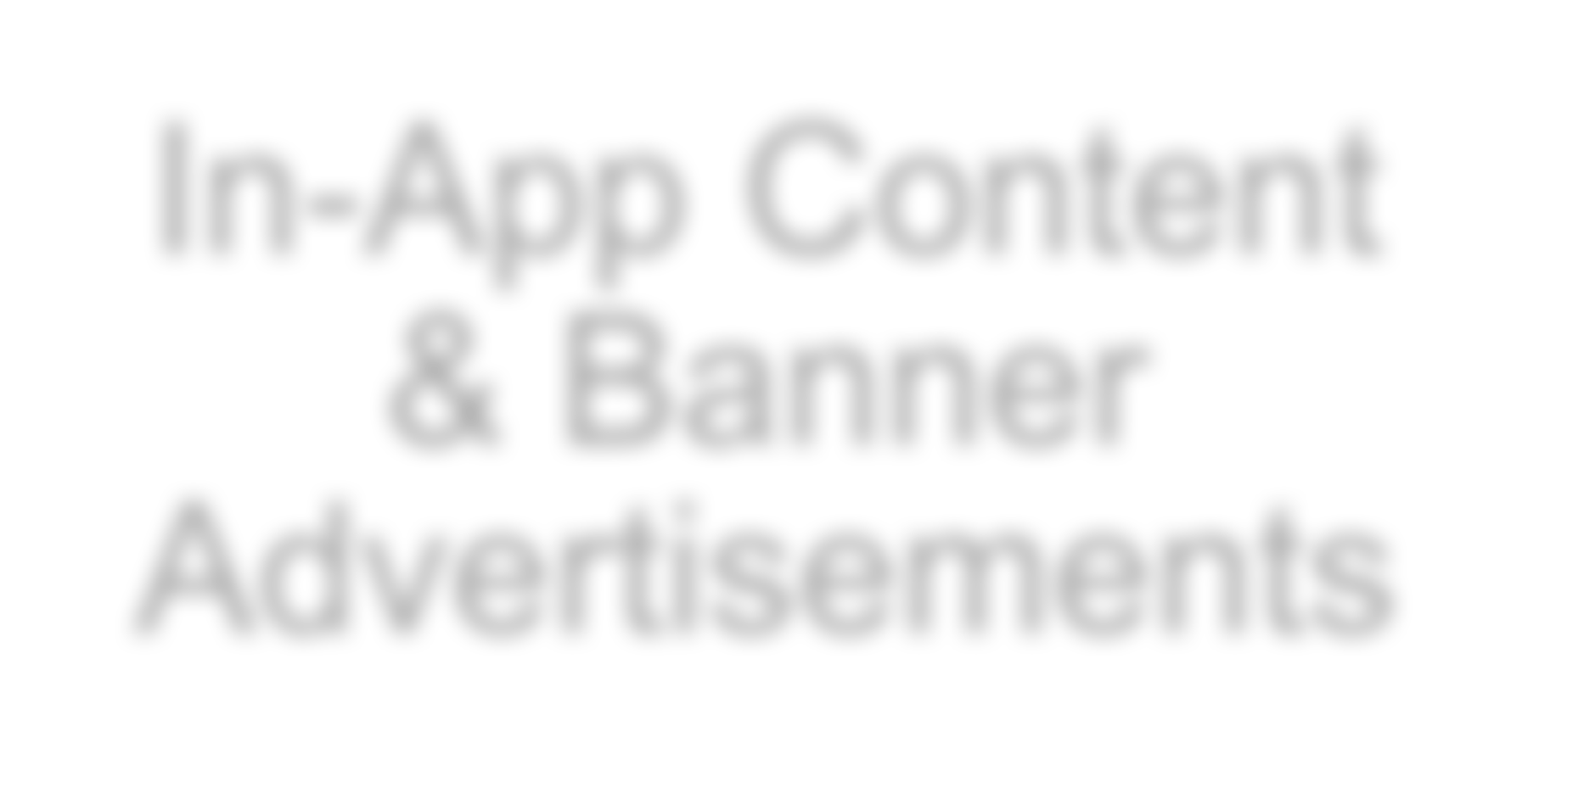
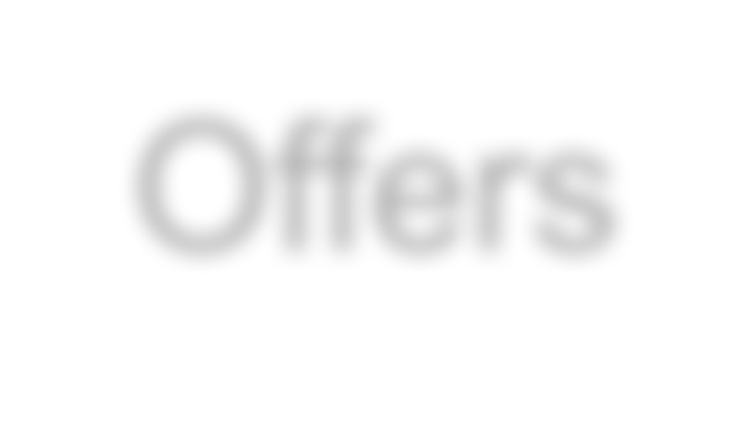
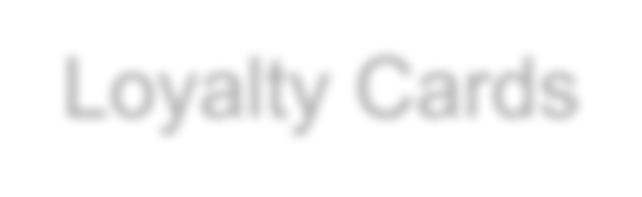
Plexure Platform Hierarchy
Owner Level (GMAL)
Merchant Level (Country/Market)
Campaigns (Marketing plans executed via Agencies)
Push Notifications
In-App Content & Banner Advertisements
Offers
Loyalty Cards
* All contents are managed or organized into the Campaign for effective management

Slide 9
User Management

Slide 10
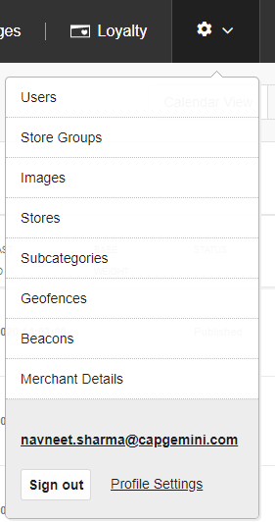
User Management
For GMAL all markets will get their own Merchant level access
Markets can create content and manage campaigns on the Merchant level
Owner level is mainly for configuration and management of segments and tags
Users in the market can grant or revoke access for the Merchant level

Slide 11
Campaign Management

Slide 12
Campaigns Management
A campaign is basically a bucket that other content is assigned and the advantage of organizing the content by campaigns is that it allows you to have a systemized view of the reporting
Plexure campaign module supports Offer, Advertisement, Loyalty card and push notifications to be grouped together based on common characteristics
Plexure campaign module has calendar view for marketing managers to visualize the content and channel deliver & list view for content managers to manage content easily

Slide 13
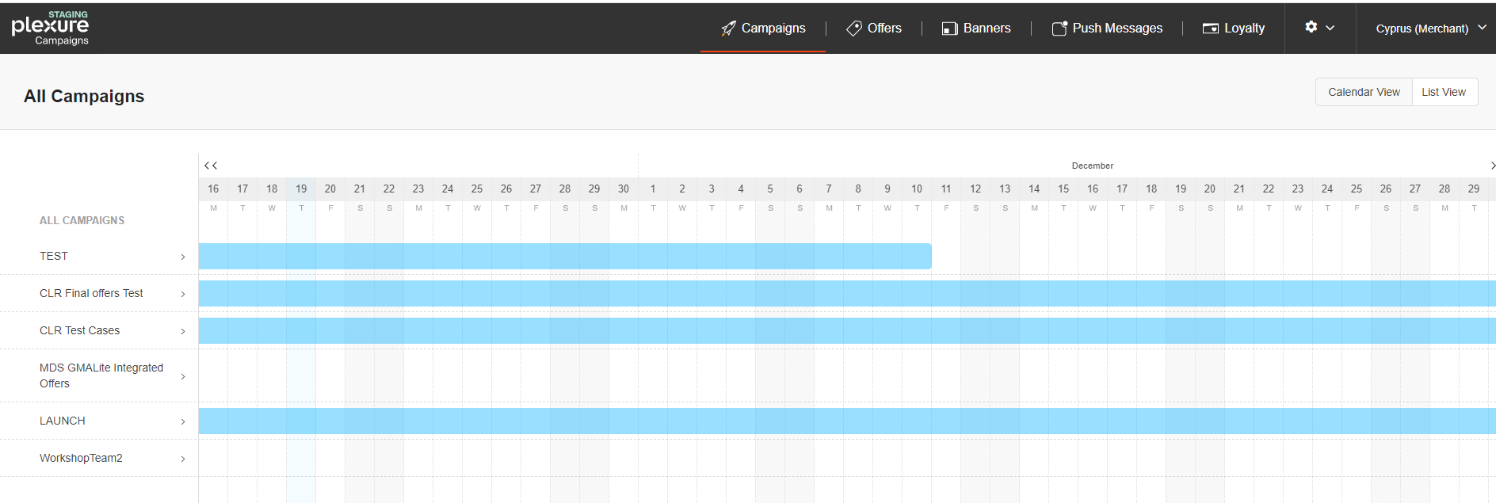

Campaigns Management
Two types of campaign views available in the Plexure platform
When the Content Manager logs into the Plexure, the Content Manager is shown the default All Campaigns view
When the Content Manager clicks on any particular campaign, the Content Manager is shown the view for the selected campaign.

Slide 14
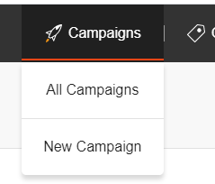

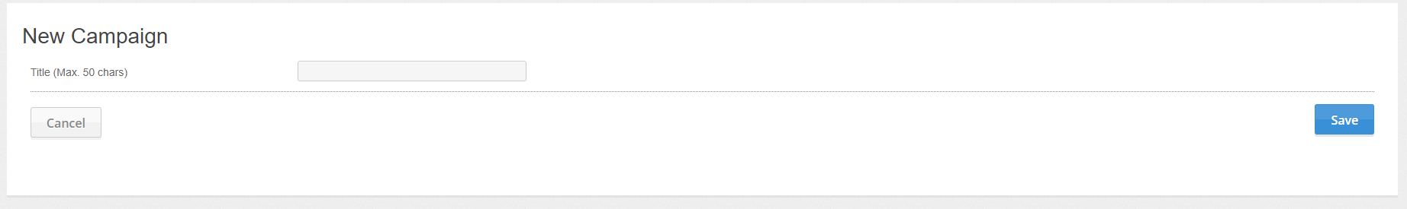
Campaigns Management
Merchant Level
Please select New Campaign

Slide 15
Offers/Deals Management

Slide 16
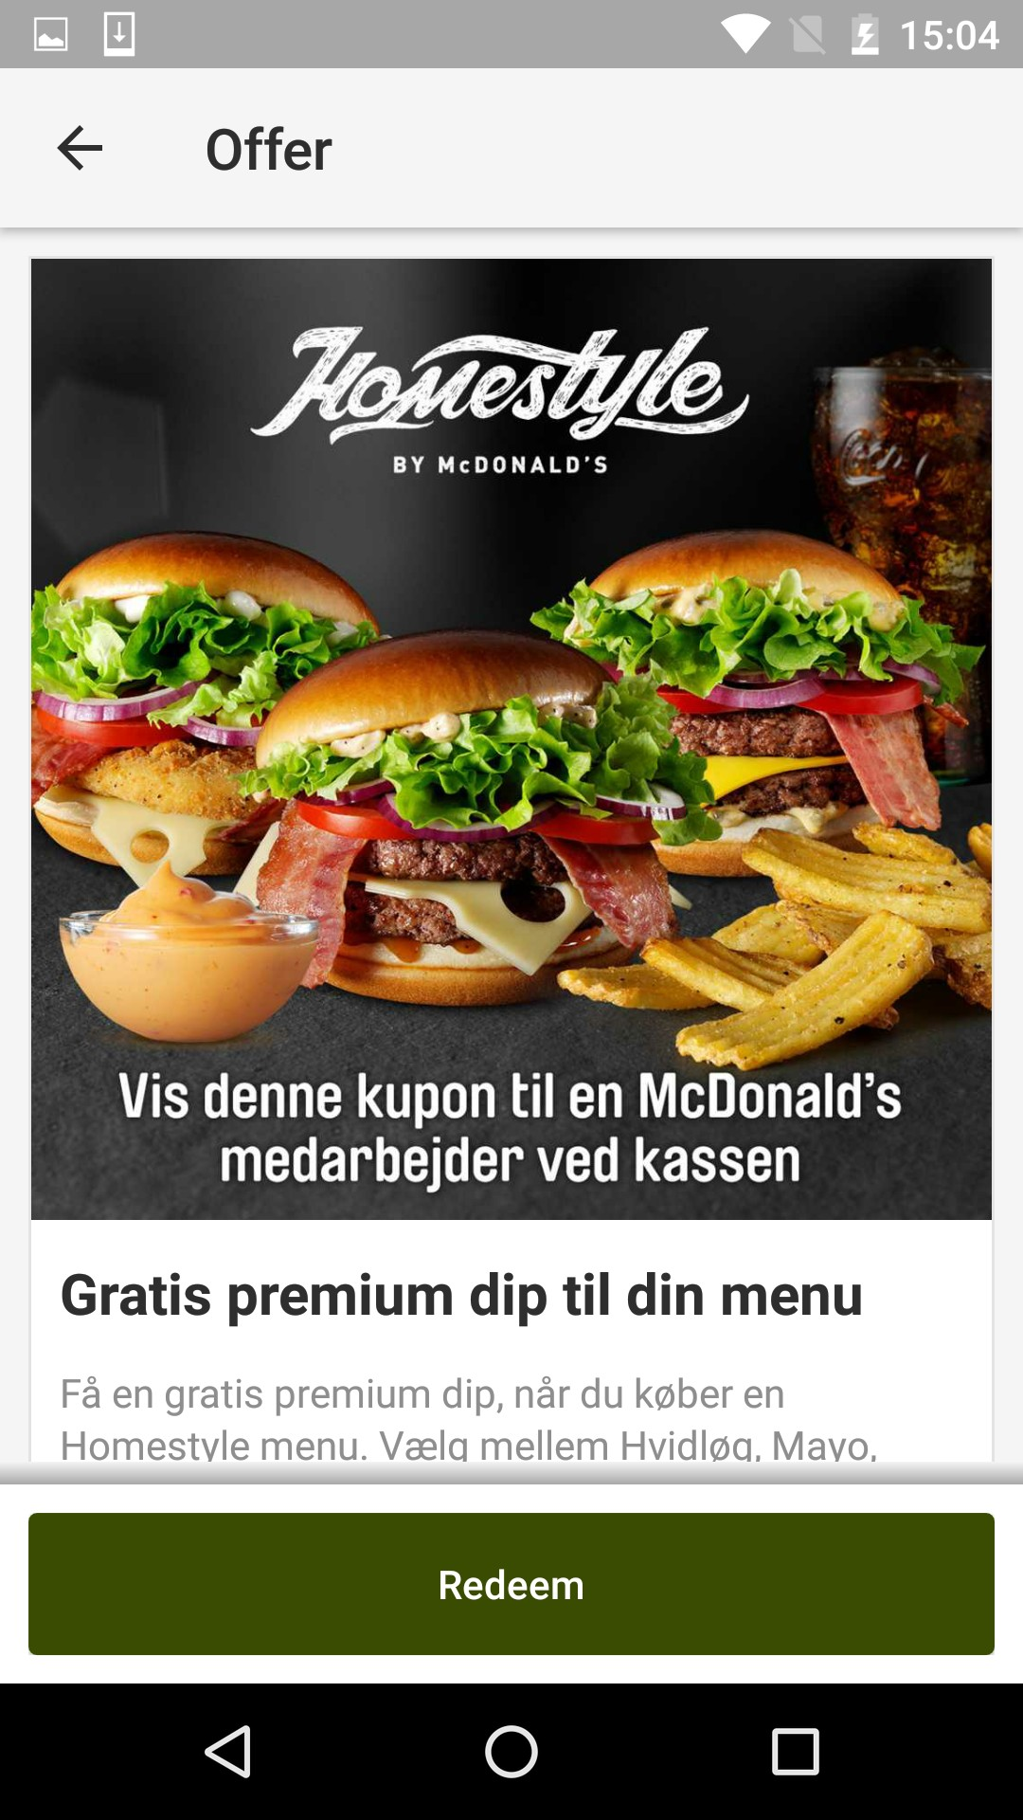
Offers Overview
McDonald’s digital team can create personalized, contextual and real time offers to increase guest count (GC), average check (AC), and overall e-coupon sales
Plexure supports Closed Loop Redemption offers for GMA Lite app
Markets will be able to create day part, week part, LTO and single use / repeatable offers as per their strategy
Offer can also be personalized by including the customer name in the offer title to give it a unique experience
Targeted offers can be planned

Slide 17
Steps in Offer Creation (CLR)
Select the Campaign for the offer
Select ‘Short Code’ type from the offer redemption option‘
Select Weighting options for order priority like base weight, consumer targeting weight, operating condition weight & Proximity weight
Define the Extended Template
Select promotional images for the offer
Enter title, start date, end date, time of day, description and terms of the offer
Enter No Compete group if applicable
Select Category of the offer if applicable
Select targeting for the offer by using tags
Publish the offer

Slide 18
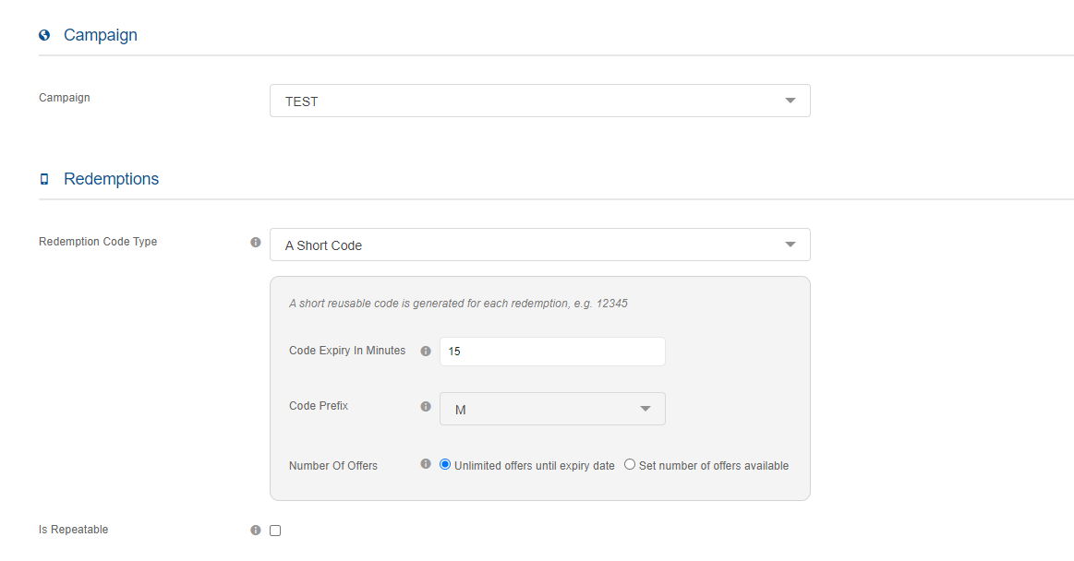
Plexure Offer Creation
1. Campaign - Select the campaign from the dropdown
2. Redemption Code Type – Short Code
Define Code Expiry Minutes

Slide 19
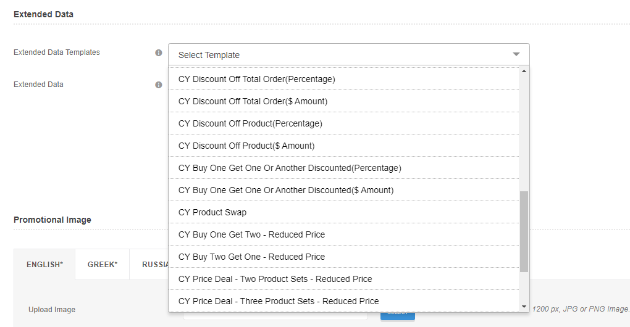
Plexure Offer Creation
3. Extended data - Selection of Market Specific Template

Slide 20
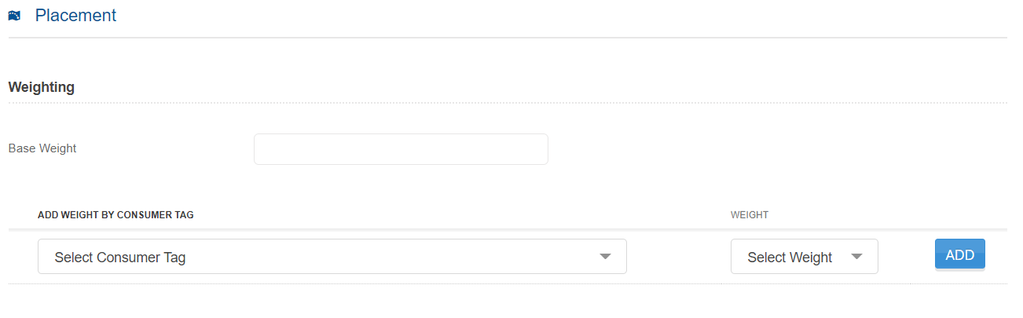
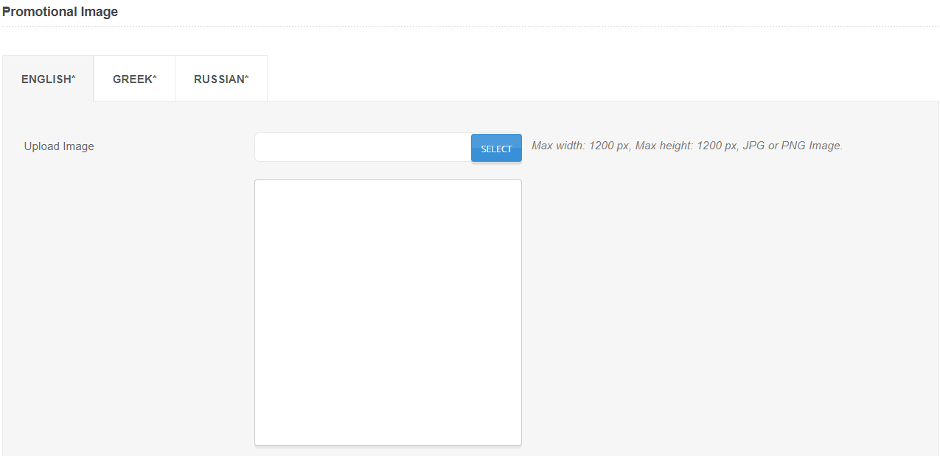
Plexure Offer Creation
4. Weighting - Weight determines order priority of the offer on the offer list. The higher the weight, the higher its order on the offer list
Base Weight – Input a base weight for the offer to control order
Consumer tag weight - Weight can be modified depending on segmentation. If you want the offer to be displayed higher in the list to a particular type of customers, select relevant tags or segments here
5. Please select the image for the offer
The image spec configured for McDonald’s GMAL app is 1200 x 1200 px

Slide 21
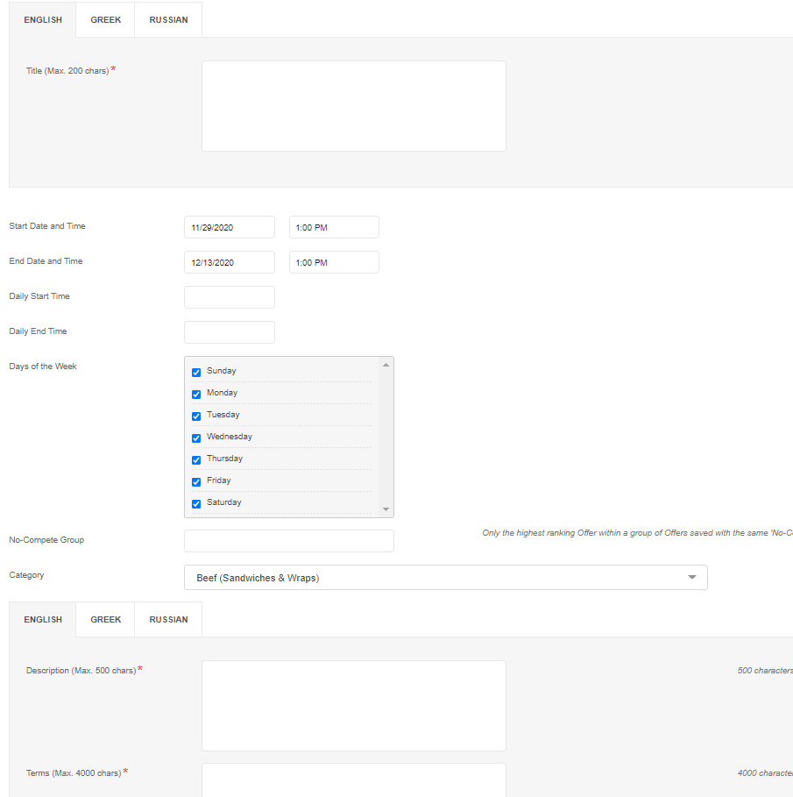
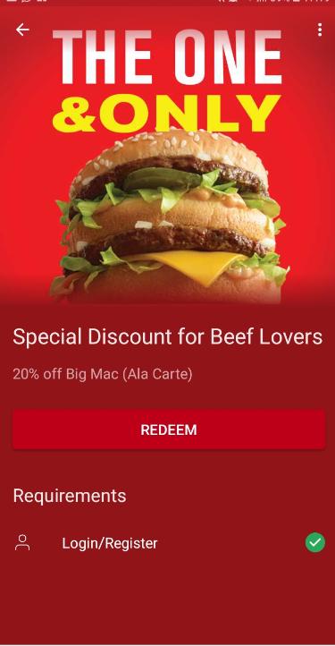
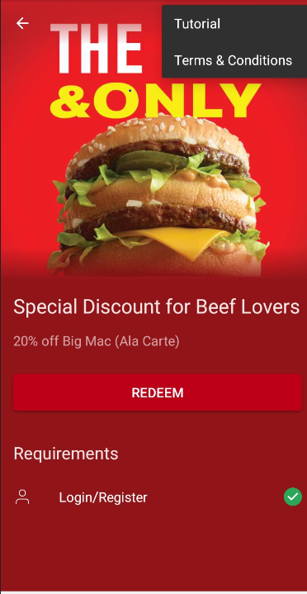
Plexure Offer Creation
6. Select basic details, offer time
7. Select category of the offer as per the marketing objective
8. Add Description and Terms & conditions of deals

Slide 22
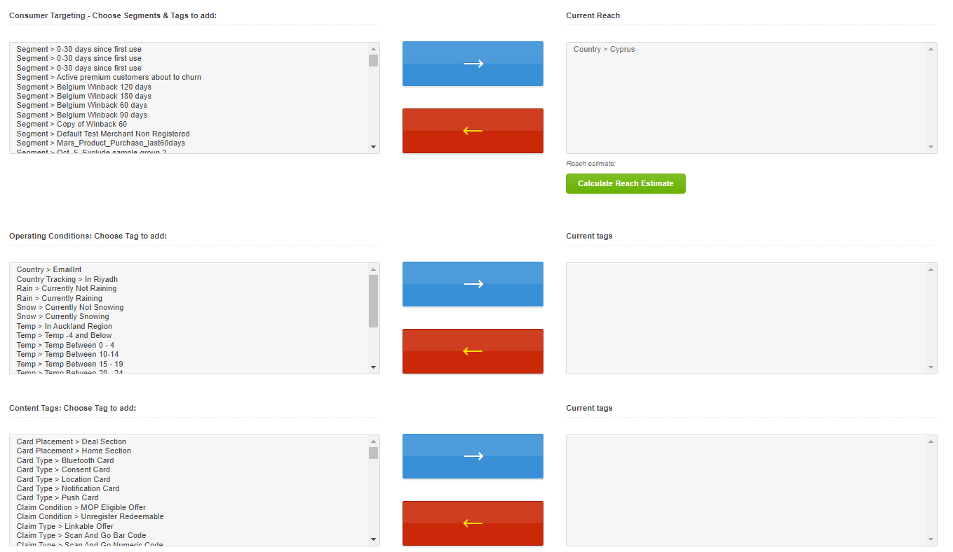
Plexure Offer Creation
9. Please select the tags in order to make the offer available for a specific customer profile (segmentation), app usage behavior or device specific properties
Offer is shown only to consumers who fit the consumer targeting tags in the “Current Reach” box. The app is configured to only show content from the merchant (country) selected by the customers
Use operating condition tags to show offer only when a particular weather condition has been met in the customer’s location

Slide 23
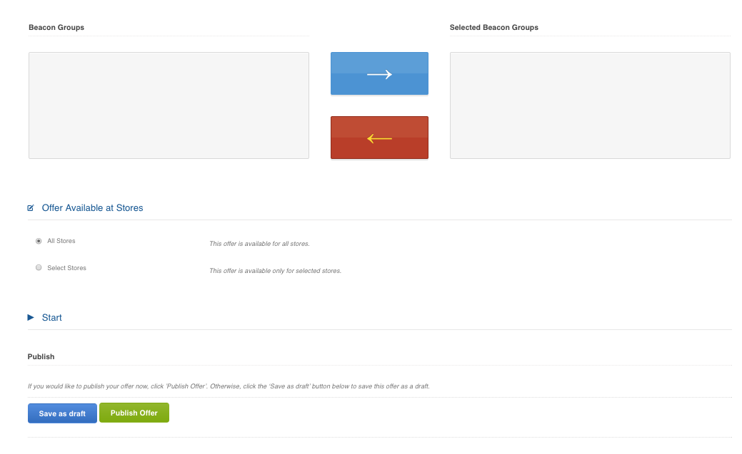
Plexure Offer Creation
Press Publish to make the offer ‘Live’ or Save as Draft button to save the offer in a draft state for making further changes at a later time
Once published, please use time filters and end date settings if you want the offer to end. If a offer is published, it cannot be put back into a draft state
9

Slide 24
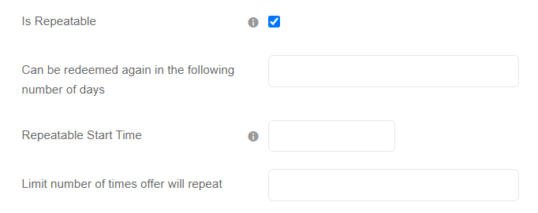

Repeatable Offers
Repeatable Offers-
Select ‘Is Repeatable’ flag while creating the offer
  Define the number of days offer will become available again
  Define the number of times offer can be repeated

Slide 25
Channel Specific Offers
How-To Configure Channel Specific Offers
When creating offers in Plexure, simply add one of the following content tags:
POD Type > Front Counter
POD Type > Kiosk / CSO
POD Type > Cold Kiosk
POD Type > Drive Through
POD Type > Walk Through
POD Type > Delivery
POD Type > Mc Cafe
Translations
The following string keys must have translations in all the languages you support in Phrase.com
gmal_deals_channel_kiosk
gmal_deals_channel_mc_cafe
gmal_deals_channel_delivery
gmal_deals_channel_cold_kiosk
gmal_deals_channel_drive_through
gmal_deals_channel_walk_through
gmal_deals_channel_front_counter

Slide 26
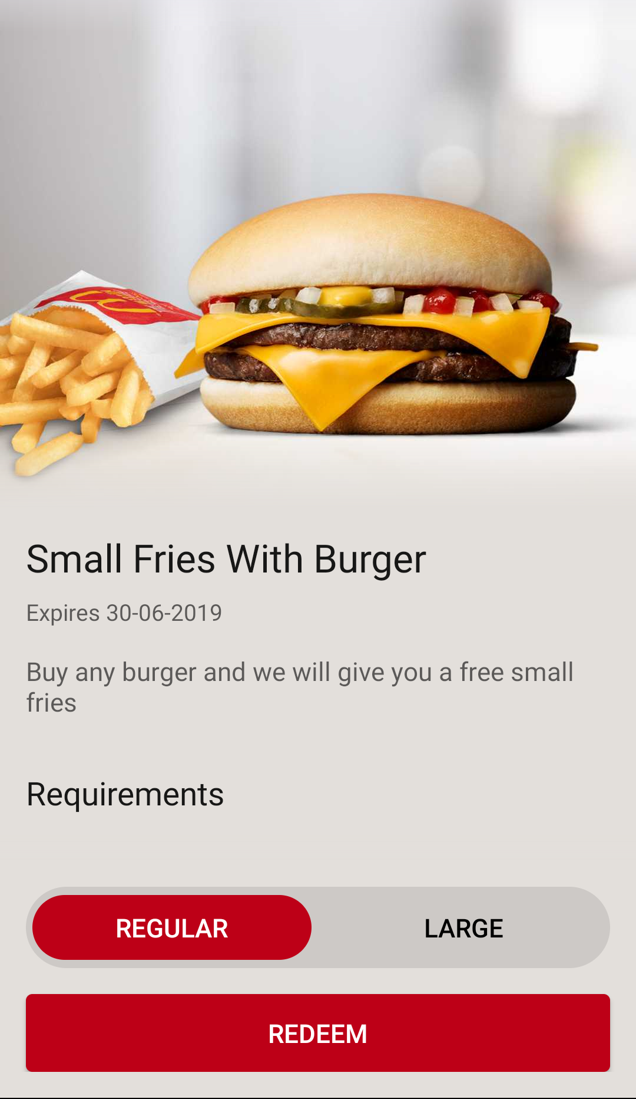
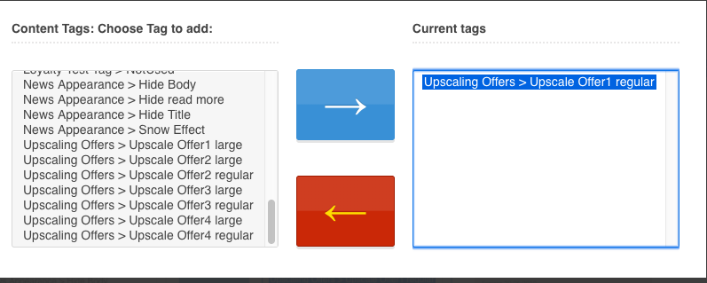
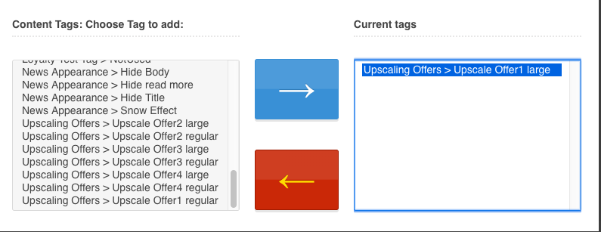
Upsizing Offers
An upsizing offer is a combination of two offers in one, where a customer can choose if they would like to have a different version of the offer. The feature is most suitable in a case where you want to provide an offer that can change their portion size.
To make the offer to be an upsizing offer, you have to add the tag "Upscaling Offers", you will find several similar tags of them. However, each tag will indicate if it's gonna be the "Regular" offer or "Large" offer and also which offer it will be combined in GMALite.
For example, there is a tag named "Upscale Offer1 regular":
Currently maximum of 20 upsizing offer can be live in the same time

Slide 27
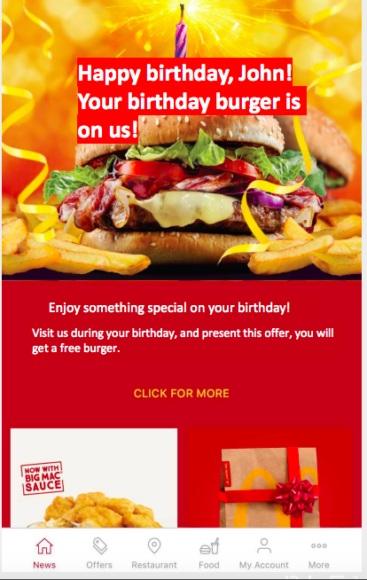
Birthday Offers
A special birthday offer can be set up in Plexure platform which can be configured to make the offer available to Birthday Customers on their Birthday Month
Advertisement of the Offer
Displaying a Hero Banner advertisement with customers name "on us!" is another way to personalize the app, get customer attention and celebrate their birthday.
We should Use deep link with Birthday Offer
“Happy birthday {{#firstName}}, {{firstName}}{{/firstName}}!”

Slide 28
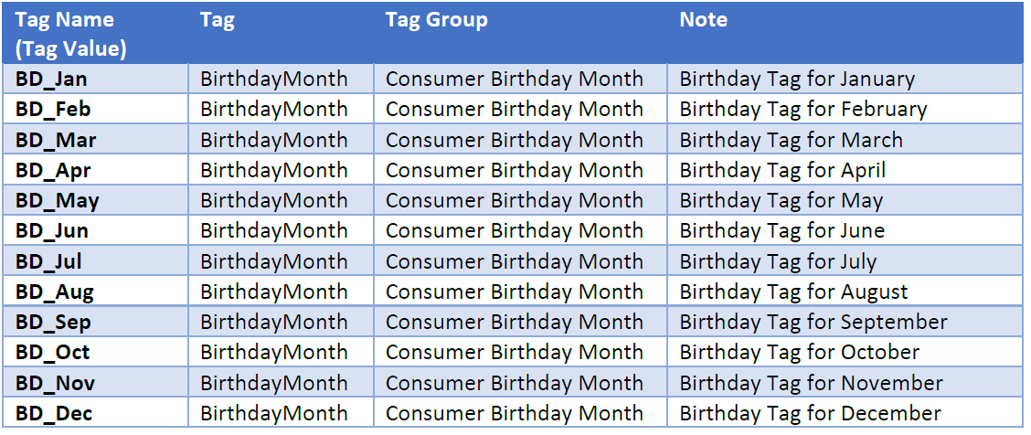
Birthday Offers
Push Message to Notify Customer
Well wishing customers on their Birthday and reminding them of their Birthday gift from McDonald's is a great way to engage with customer
Tags to use for Push Messages

Slide 29
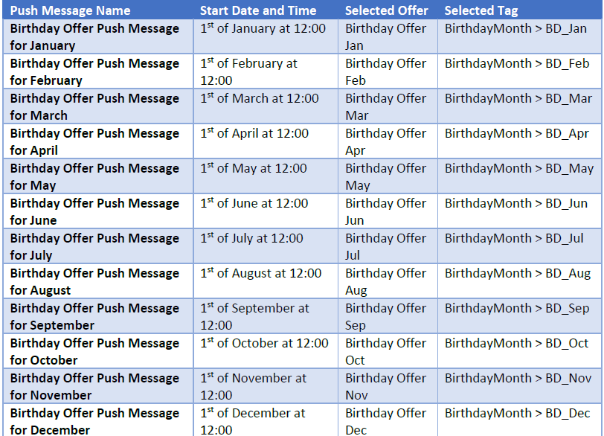
Birthday Offers
Push Message to Notify Customer
One push message can be configured the “Start Date and Time” only one Date and Time. To have the push messages sent out for 12 months, 12 push messages will need to be configured as the examples in the following table.

Slide 30
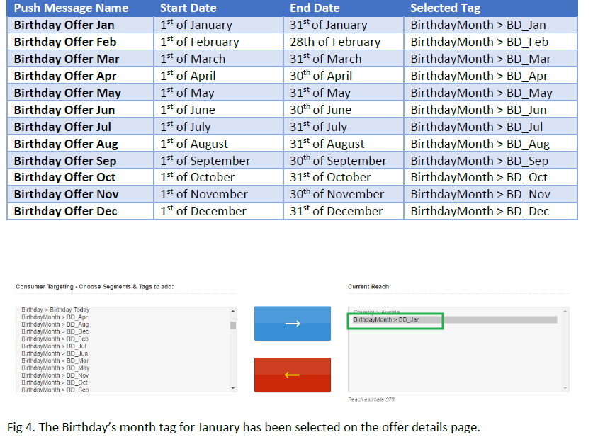
Birthday Offers
Offer Creation
When configuring offers, under Filter – Consumer Targeting – Choose Segments & Tags to add section the created birthday’s month tags will need to be selected here.
To prevent customers from receiving birthday offers more than once a year, the configured birthday offer will need to be updated / configured with the Birthday’s month tag that is matched with the current month. This will be a manual process that will need to take place every month.

Slide 31
Adverstisement Management

Slide 32
Plexure Content & Advertisement
Content managers have full control to manage properties of in-app content for example
Banner Advertisement status and time controls including day part, day of the week, daily time intervals
Advertisement title, description, terms & conditions, images & content
Advertisements can be given a personalized experience by including the customer name
Advertisement ranking and order priority
Advertisement targeting and audience selection by using tags
Connecting Advertisements to in app content, external links or in-app webpages
Geofence and Beacon targeting for in app content
Weather targeting for promotional content

Slide 33
Steps in Advertisement Creation
Select the campaign for the Advertisement
Select the Placement type as ‘Card’
Enter Basic Properties like Title, Description, Start & End Date Time, Days of week
Enter the Click through URL for the advertisement
Upload the Image for the advertisement
Select the filters and tags for targeting purposes
Select the weighting for the advertisement
Publish the Advertisement

Slide 34
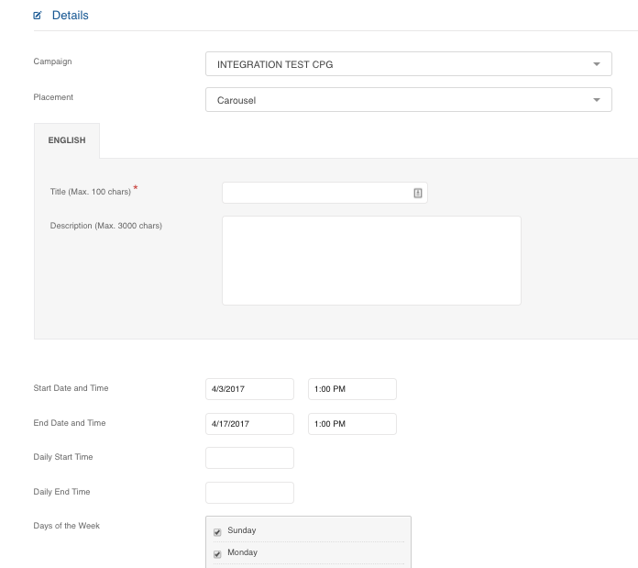
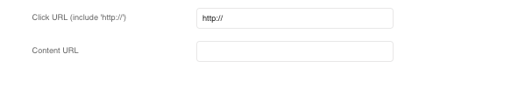
Plexure Advertisement Creation
Select the Campaign for advertisement
Select the placement type as ‘Card’
Select Title, Description, Start date and time, End date and time, Daily and weekly time filters for the advertisement
Select Click Through URL and content URL
Click Through URL can be configured to open links within the app (web view) or open outside the app in the native browsers
Content URL can be used to play music or video when customer interacts with the advertisement
Multi-Language Support for Banner Ad Click URLs
1
2
3
4

Slide 35
Linking Banners to different Section of App
Click through URL Links to be used -
News Section - gmalite://gmalite-news
Deal / Rewards Section - gmalite://gmalite-deals
Particular Offer/Deal** - gmalite://gmalite-deals?offerid=<offer id>
My Profile section - gmalite://gmalite-account
Market Picker section - gmalite://gmalite-marketpicker
Smart Web Views - gmalite://gmalite-smartweb?weburl=<url>
      Example: gmalite://gmalite-smartweb?weburl=www.mcdonalds.com
      ** Separate URL can be configured for English & Local language
Very Important

Slide 36
Linking Banners to different Section of App
Click through URL Links to be used -
Restaurant Finder-
  gmalite://gmalite-restaurant
  gmalite://gmalite-restaurant?list=true
  gmalite://gmalite-restaurant?restaurantid=<restaurantid>
Nutritional Section –
  gmalite://gmalite-smartweb?weburl=https://nutrition-web-dot-prd-euw-gmal-mcdonalds.appspot.com/<country_code>/<language_code>/home
  gmalite://gmalite-smartweb?weburl=https://nutrition-web-dot-prd-euw-gmal-mcdonalds.appspot.com/<country_code>/<language_code>/category-view/<category_id>/
  gmalite://gmalite-smartweb?weburl=https://nutrition-web-dot-prd-euw-gmal-mcdonalds.appspot.com/<country_code>/<language_code>/item-view/<category_ID>/<product_ID>/
Very Important

Slide 37
Web View Page Orientation
You can determine device orientation by specifying appOrientation in the url
For example:
gmalite://gmalite-smartweb?weburl=http://www.exampledomain.com/examplepage.html?appOrientation=landscape
This will launch and keep the smart web view in landscape until the user navigates to another section.
Valid options are:
  landscape,
  portrait and
  user

Slide 38
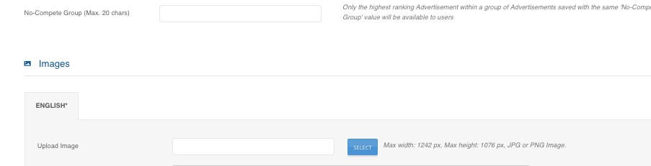
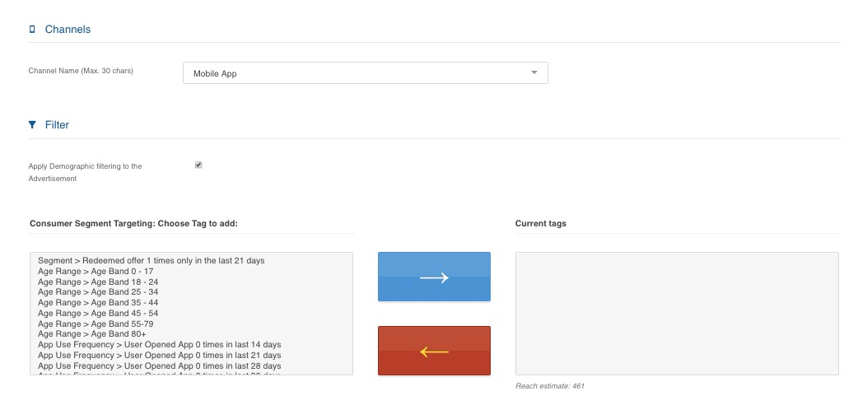
Plexure Advertisement Creation
5. Select the No-compete group if you want platform to only show one advertisement from a group of advertisement in a group. The highest ranking advertisement will appear first followed by other
6. Upload the image for the advertisement. Images uploaded using Plexure platform have to be uploaded with recommended size of 1200 x 1200 px. Plexure platform can automatically crop them after uploading
7. Select the tags to make the advertisement available for a specific customer profile (segmentation), app usage behavior or device specific properties
6
7

Slide 39
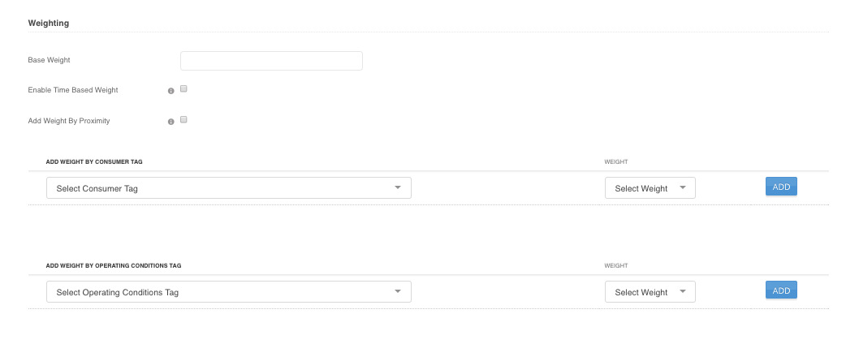
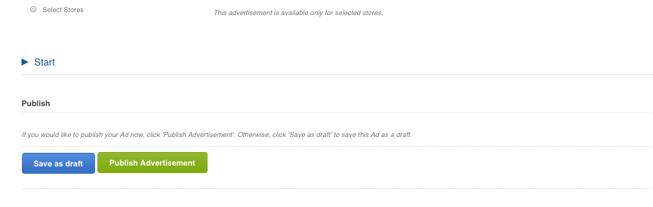
Plexure Advertisement Creation
Weighting - Weight determines order priority of the advertisement on the offer list. The higher the weight, the higher its order on the advertisement carousel
Base Weight – Input a base weight for the advertisement to control order
Consumer tag weight - Weight can be modified depending on segmentation. If you want the advertisement to be displayed higher in the list to a particular type of customers, select relevant tags or segments here
Time based weight – If this check box is ticked, platform will add additional weight automatically closer to the ‘event’ start time
Press Publish to make the Advertisement ‘Live’ or Save as Draft button to save the advertisement in a draft state for making further changes at a later time
8
9

Slide 40
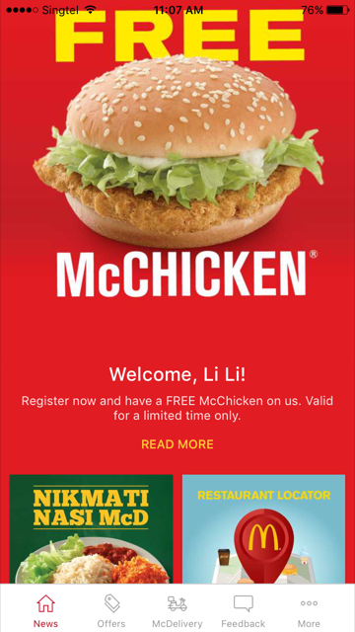
Dynamic Copy
Offers and Banner Ads can now include customer's first and last names in the titles or descriptions to give a more personal touch to the message
This is how you would write the Banner Ad title in the example shown on the right:
Welcome {{#firstName}}, {{firstName}}
{{/firstName}}!

Slide 41
Advertisement Creation Summary
Please ignore the following fields on Advertisement creation as these are not applicable for GMAL
Event Start time
Extended Data
Content Tags
Assets
Channel
•
•
•

Slide 42
Push Notification Management

Slide 43
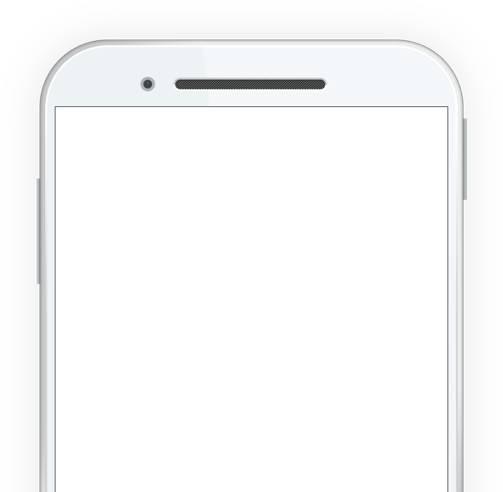
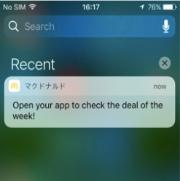
Push Notification Capabilities
Content managers can personalize, target and link content types to a notification
Content managers can control the limits around how many notifications should be sent to a customer over a period of time
Content managers can also specify start date, end date, time of day, and days of the week for the push notifications

Slide 44
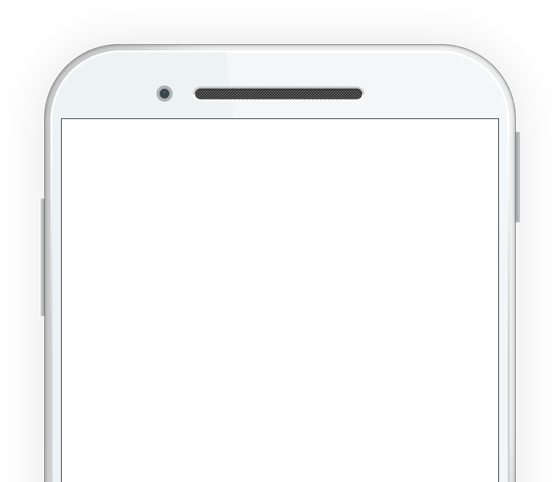
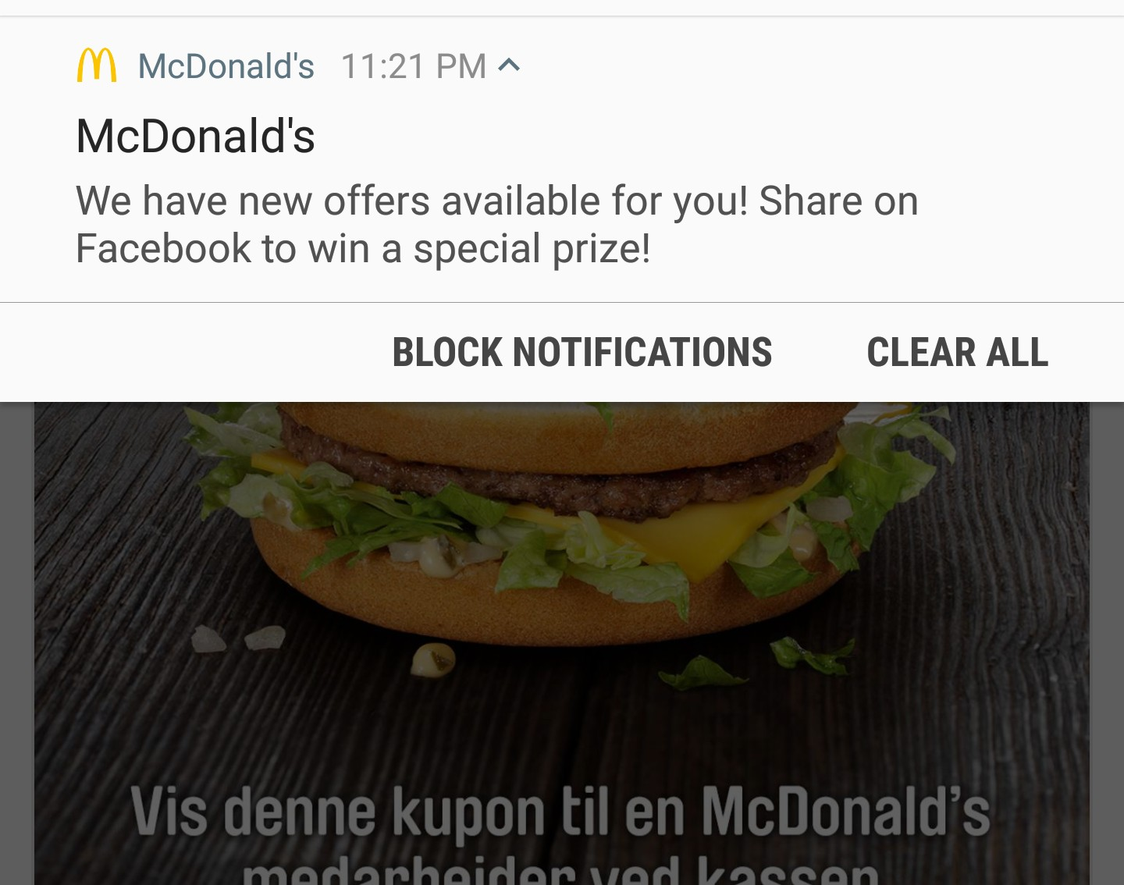
Push Notification Capabilities
Push Messages can be linked to an offer in the app
All push messages will appear in the notification centre for both iOS and Android
The platform will automatically apply the right market tag at the time of creation
Location services to be enabled and store data to activate for Geofence and Beacon notifications

Slide 45
Push Notification Capabilities
Push Messages can be linked to an offer in the app
All push messages will appear in the notification centre for both iOS and Android
The platform will automatically apply the right market tag at the time of creation
Location services to be enabled and store data to activate for Geofence and Beacon notifications

Slide 46
Push Messages
Plexure supports the following four types of push messaging:
Broadcast: This is a push message sent to a selected audience at a set point in time
Recurring: This is a recurring broadcast push message, most commonly used for sending out birthday push messages
Geo-fence: This is a push message setup for a period of time and triggered by a consumer entering the geo-fence
Beacon: This is a push message setup for a period of time and triggered when a consumer is in proximity to a Bluetooth beacon
Direct Push Message can be used to send a message to individual customers (who have the app installed and approved of Push Messages). Mainly used by Plexure system to send push message based on event.

Slide 47
Steps in Push Message Creation
Select Broadcast Push Message from new message creation screen
Select a friendly name for the Push message for reporting
Select the campaign for the push message
Enter the message copy and select the date and time for the push message. The push message is always sent relative to consumer device time zone
If you want to deeplink an offer, please select offer from the dropdown list on the platform
Select Android ONLY or iOS only features if required
Select tags for targeting the push message to a specific audience
Start the Approval Flow for the message

Slide 48
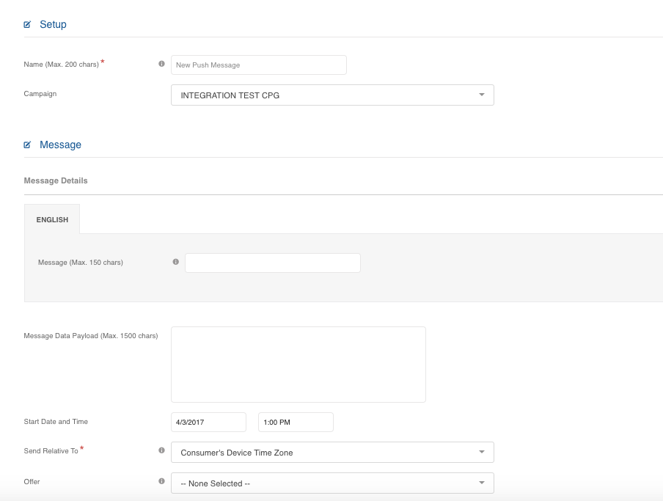

Plexure Broadcast Message Creation
Select Broadcast Option to start the push message creation
Select a friendly name for push message for reporting and analytics
Select the campaign for the push message
Enter the content/copy of the push message
Select the offer from dropdown if you want to deep link an offer
1
4
5

Slide 49


Plexure Broadcast Message Creation
Select Android Only additional field (Title) if required. For iOS you can select Badge number for a small number identifier to appear on the app icon. Please ignore Sound option. (App development is required to enable these features)
Select the tags to target the push message to a specific audience or a target group. Please use Android or iOS device tags if you want to target by OS
Click Get Approval and Activate to trigger the publishing workflow. The approver will receive an email with an option to Approve or reject a message
6
7
8

Slide 50
Push Messages Approval Process
Push messages are different from other types of content (offers, banner ads, loyalty cards) in that they require email authorization before they are published and sent out.
Each market will have a push message approver for the publishing workflow. It can be a mail group or a single email address.
When a campaign manager clicks Get Approval and Activate an email requesting approval is sent to the nominated approver, who can then review the copy and details of the push message and either accept or reject it.
The message will go in batches at the specified time only after approver has approved the message

Slide 51
Feedback, questions?

